Slide 1
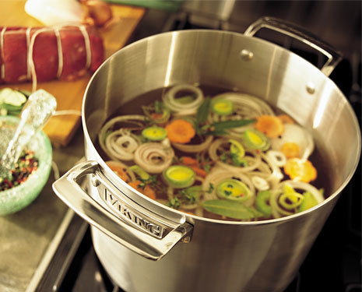
Stocks, Sauces and Soups

Slide 2
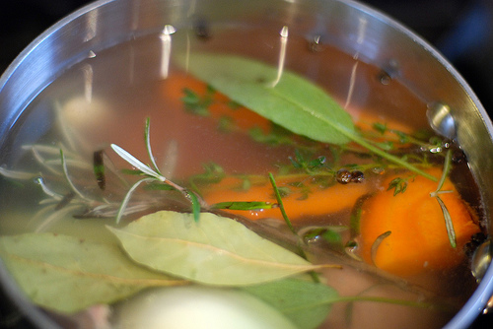
What is Stock?
A flavorful liquid made by gently simmering bones and or vegetables.

Slide 3
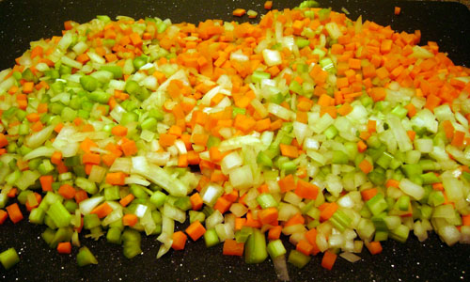
4 Essential Parts to Stock
Mirepoix – 2 parts onion, 1 part carrot, 1 part celery roughly chopped.
Aromatics – herbs and spices, thyme, parsley stems, bay leaf, cracked pepper corn – in a cheesecloth bag or not.
Liquid – most often water
Major flavoring ingredient –
bones or vegetables

Slide 4
Preparing Stock
Combine bones or vegetables in cold water or liquid
Bring to a simmer
Skim as necessary
Add mirepoix and aromatics at the appropriate time
Simmer until correct flavor and color
Strain, use immediately or cool and store
Ice bath, stir often
Small containers
Chill blaster

Slide 5
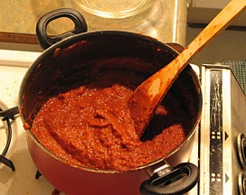
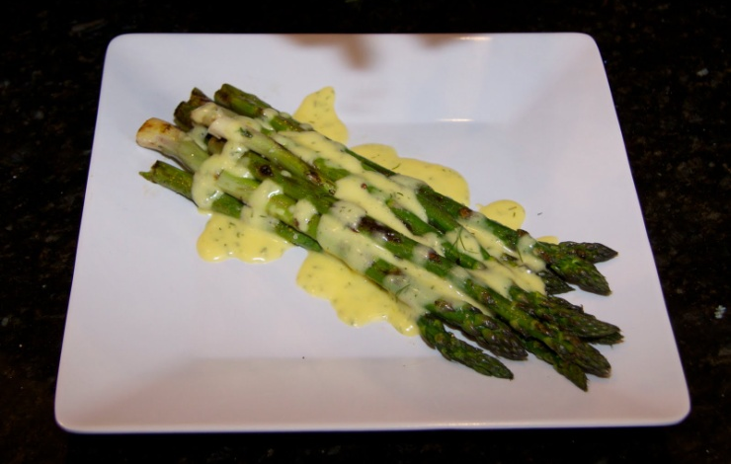
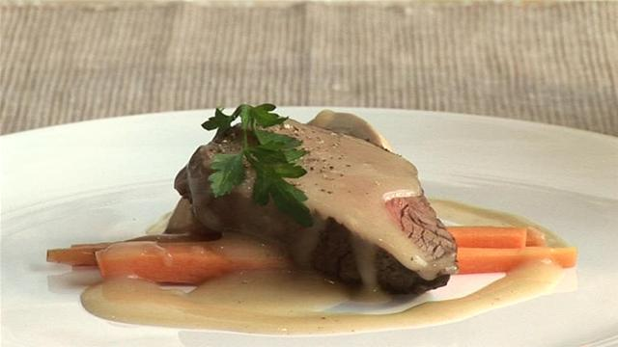
Grand or Mother Sauces
Bechamel – milk and white roux
Veloute – veal, chicken or fish stock and a white roux
Brown or Espagnole – brown stock and brown roux
Tomato – stock and tomatoes
Hollandaise – eggs, butter and lemon

Slide 6
Thickeners for sauce and soup
Roux – white, blond or brown - Equal parts of flour and fat, melt butter stir in flour, cook and stir. Color depends on how long you cook it.
Beurre manie – equal parts of solid butter and flour, added in pea sized balls.
Slurry – cornstarch mixed with cold liquid
Liaison – egg yolks and heavy cream

Slide 7
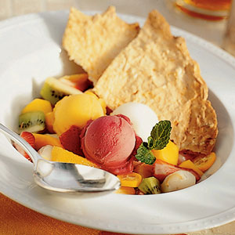
Soups
Clear (stock) and thick (cream)
Appetizer Soup – simple, small, clean
Side Dish Soup – complements meal, smaller portion
Main Dish Soup- hearty, lots of protein, larger portion
Dessert Soup – cold, fruity,
smoothie in a bowl

Slide 8
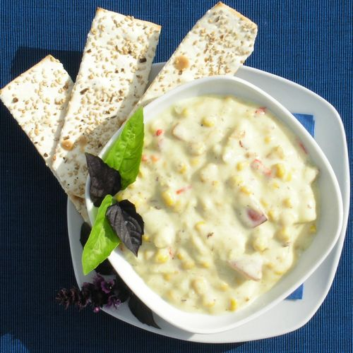
Thick Soups
Cream – made by adding thickeners – smooth texture
Puree – thickened by starch in ingredients such as potatoes
Bisque – cream soup made from shell fish
Chowders – cream soup with chunks

