Slide 1
Potatoes and Grains

Slide 2
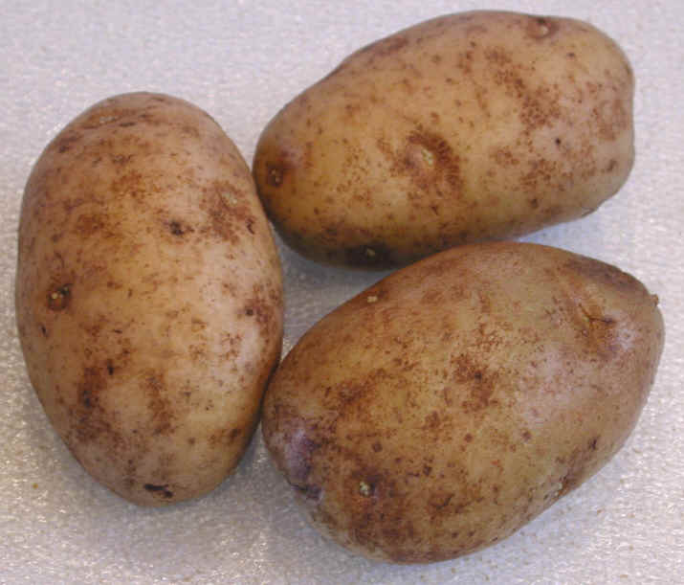
Potatoes
Native to North and South America
Select potatoes that are firm and smooth
Store in a cool dry place 45-55 degrees
Maximum storage is 30 days
Harvested in October stored all year
Solanine: green color due to exposure to light – cut and discard
Inexpensive

Slide 3
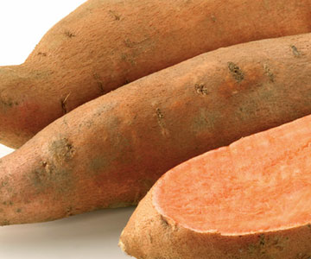
Sweet Potatoes
Tan to brownish red
Orange mealy flesh
High in sugar
Suited to boiling, baking, roasting and pureeing
Not related to the Yam

Slide 4
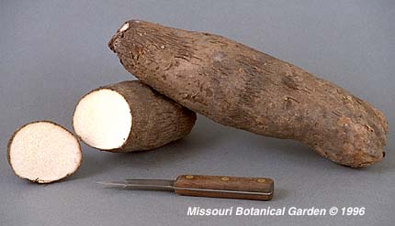
Yams
Similar to sweet potatoes
Originated in Asia
Less sweet than sweet potatoes
Used almost interchangeably
Baking, Pureeing, Frying

Slide 5
Russet Potatoes (Idaho Potatoes)
Standard white baking potato
Skin is brownish-red
Flesh is mealy and white
Excellent for baking and frying
Available in many shapes and sizes

Slide 6
Chef’s or all Purpose
Usually drier and less starchy than russet potatoes
Less expensive than russets
Usually irregularly shaped
Great for mashing, pureeing, in salads, scalloped, casseroles, soups and sautéing.

Slide 7
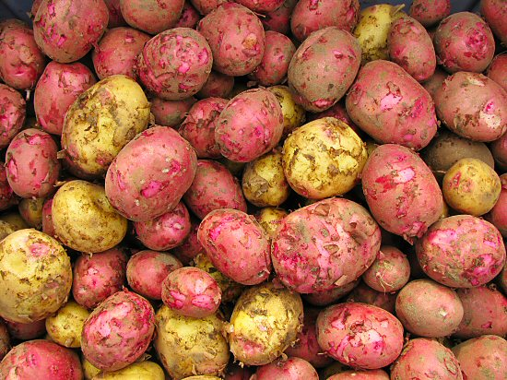
New Potatoes
Small immature red potatoes
High in moisture and sugar
Low in starch
Great for boiling and steaming

Slide 8
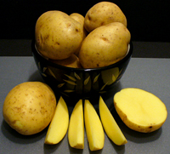
Yellow-fleshed
Increasingly popular in US
Golden color and buttery flavor
Yukon Gold is well
known variety
Baking, mashing, frying, whipping or roasting

Slide 9
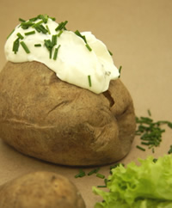
Cooking Potatoes
Single Stage
Potatoes are taken from the raw to finished state by using one method.
For example: baking or boiling

Slide 10
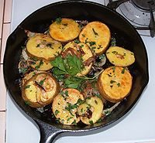
Cooking Potatoes
Multiple Stage Technique
Cook with one or more methods
Finish with another method
Examples: Lyonnaise,
funeral potatoes,
twice baked

Slide 11
Cooking Methods
Method | Description
Boiling | Easiest, first step for other methods
Steaming | New potatoes
Baked | Russets, wrap in foil- moist, rub with oil- soft skin nothing- crispy skin scrub, pierce with a fork
En casserole | Sliced raw, cooked with cream sauce or uncooked custard Toppings – bread crumbs, cheese, etc…
Sautéed | Hash browns
Deep-Frying | French fries, Russets because of low moisture
Pan-Frying | Latkes – potato pancakes
Pureeing | Mashed or whipped potatoes, first steam, boil or bake

Slide 12
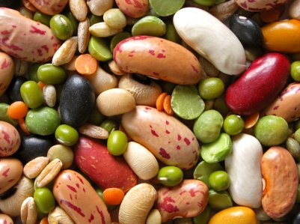
Legumes
Legumes are Seeds
This includes beans, peas, lentils, nuts and seeds

Slide 13
Selection, Storing and Cooking
Available fresh, caned, dried or frozen
No torn bags or dented cans
Store in a cool, dry, well-ventilated area
Dried: rinse, sort, soak, rinse, cook
Soups, stews, salad, side or main dish
Red beans & rice
Kidney beans and chili
Black & Pinto beans Mexican food
Chickpeas for hummus
Soy nuts for a snack

Slide 14
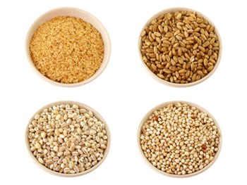
Grains
Grains are grasses that grow edible seeds
Milled grains have the germ, bran & hull removed
Bran is great fiber source
Endosperm largest part of the grain

Slide 15
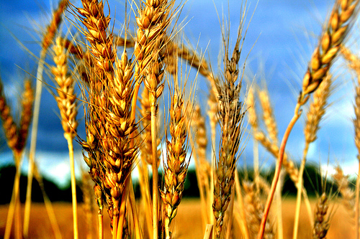
Types of Grains
Wheat
Wheat Flour
Rice
Corn
Oats
Other- Buckwheat, Kasha, Millet, Rye, Teff, Amaranth, Spelt, Quinoa, Barley

Slide 16
Selection, Storage & Cooking
Check all boxes, bags & containers
Store in dry and ventilated area
Soak whole grains before cooking
Steam, pilaf (sauté in butter then simmer) risotto (release starch to make creamy dish – add small amounts of liquid stir until it is absorbed)

Slide 17
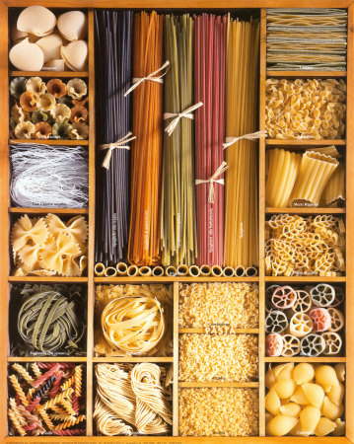
Pasta
Means paste
Dried, fresh or frozen
Dumplings (ravioli, pierogi, gnocchi)

Slide 18
Cooking Pasta
Pasta is done when it feels firm to the bite or al dente.
Fresh pasta cooks in 1-2 minutes.
Dry pasta takes much longer (depends on shape and size).
Boil in lots of water, no lid on the pot, Stir occasionally, Drain and drizzle with a little olive oil or toss in sauce to keep from sticking.

Slide 19
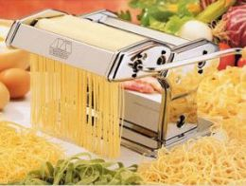
Making Fresh Pasta
Ingredients: eggs, salt, oil and flour
Can add herbs, spices or vegetables
Dough should rest before rolling
Can roll in machine or by hand

Slide 20
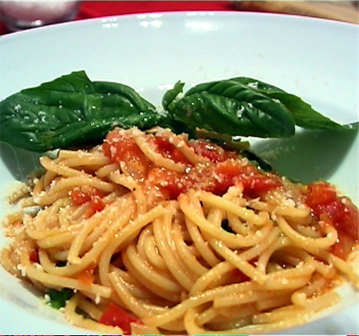
Serving Pasta
Match pasta with sauce
Heavy, thick pasta with heavier sauces
Filled pasta only need a light sauce – don’t want flavors to conflict
1 lb dry pasta yields 3 lbs cooked pasta
1 lb fresh pasta yields
2-2 ½ lbs cooked pasta

Slide 21
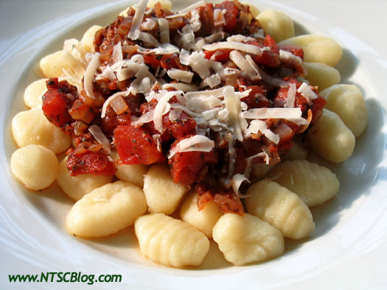
Cooking Dumplings
Made from dough, batter, bread or potatoes
Roll into small balls
Make sure they get cooked
Cook by:
Simmering
Steaming
Poaching
Baking
Pan Frying
Deep Frying
Broiling

