Slide 1
Standard 3 – budgeting, consumer skills to manage food costs.

Slide 2
Budgeting
A budget is a plan for managing money that can help consumers get more from their money.
Than challenge is to provide wholesome meals without spending a lot of money.

Slide 3
Categorized Shopping List
A shopping list helps consumer remember what they need to buy.
Group items on a shopping list in the order they are arranged in the store.
A list saves time and money

Slide 4
Take a Calculator
Calculating food as you shop helps to keep track of spending and to stay within your budget.

Slide 5
Don’t shop when hungry or tired
Savvy consumers avoid shopping when they are hungry.
People spend up to 15% more on food when they are hungry, this leads to impulse buying.

Slide 6
SHOP ALONE
Those that shop alone spend less money because they aren’t being persuaded by others to make impulse buys.

Slide 7
Identify shopping guidelines and advertising strategies
Loss Leaders
Coupons/rebates
Impulse buys
Layout of store/shelf placement
Package dating
Calculate unit pricing/cost per serving
Interpret package information
Name Brands vs. Store Brands
Convenience Foods

Slide 8
Loss Leaders
Sale items that are sold at such a low price the store makes very little profit or actually money.
Loss leaders are usually advertised on big signs and store windows.

Slide 9
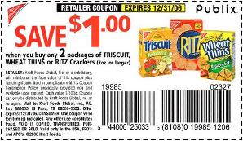
Coupons/Rebates
Coupons offer savings on specific products. When matched with store sales, consumers can often save money on a name brand item.
Rebates are partial or full refund from the maker of an item.

Slide 10
Impulse buys
Most grocery purchases are on impulse, unplanned.
Groceries usually make more money on impulse buys rather than staple items like: bread and milk.

Slide 11
Layout of Store/Shelf Placement
Grocery Stores are like Casinos….
Layout: Foods that appear most often on grocery store lists are often placed at the rear of the store.
Shelf Placement: “Bulls eye zone” front and center at eye level. These items are priced higher. Specialty items are placed on top shelf and store brands on bottom shelf.

Slide 12
Package Dating
Some packages are stamped with a date that indicates how fresh a product is and how long it can be used before it expires.
Sell by date is the last day the product should remain on the store shelf.

Slide 13
Calculate unit Pricing/Cost Per Serving
Unit pricing is the cost per ounce, quart, pound, etc.
Most stores show the unit price on the shelf.
To calculate: divide the items total price by the number of units.
Ex 1: If Brand X costs $3.99 for 32 oz, let's figure out the unit cost of Brand X (the cost of 1 oz). It's easy!!! Divide $3.99 by 32 and round to the nearest tenth (the cost goes inside the division box). The unit cost is approximately $0.12.
Ex 2: If Brand Y costs $4.25 for 3 lbs, let's figure out the unit cost of Brand Y (the cost of 1 lb). Divide $4.25 by 3 and round to the nearest tenth. The unit cost is approximately $1.42.

Slide 14
Interpret package information
Wrappers on food packages are full of details about the food inside.
Food labels are part advertising and part information.

Slide 15
Name Brands VS. Store Brands

Slide 16
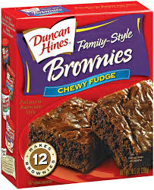
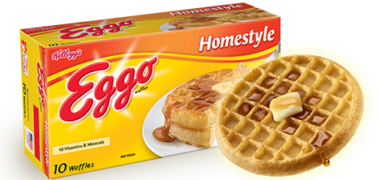
Convenience Foods
No nutritional value
Saves time and does
not cost a lot of money

