Slide 1
Meal Planning
Foods 2
Unit 9 and Unit 11
Natalie Johnson

Slide 2
Dietary Guidelines/MyPlate
http://www.health.gov/dietaryguidelines/
http://www.choosemyplate.gov/

Slide 3
Aesthetics
Color: variety of different colors
Texture: aim for variety of textures
Flavor: using foods with similar flavors
Temperature: keep hot foods hot and cold foods cold. Appropriate for the weather.
Size and Shape: use a variety to add interest.

Slide 4
Food Presentation (Plating)
Avoid placing food on the rim of plate
Avoid overfilling the plate – allow for white space
Avoid the use of non edibles on the plate
Odd numbers are more pleasing than even numbers.

Slide 5
Cost and budget when meal planning
Consider # of family members, ages, income, etc.
Plan menus
Plan menu based on local grocery store sales!

Slide 6
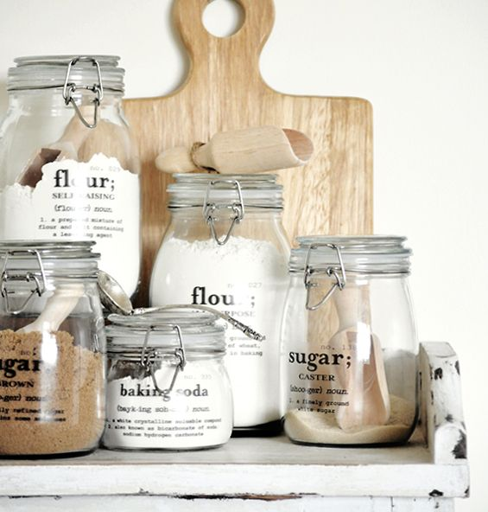
Work Plan…
Organize the timing of the meal, all dishes done at the same time.
Organize so most often used items are within easy reach. Ex: salt and pepper
Make extra food to use for later meals.
Everything in its place – make sure you have everything you need before beginning.
Clean as you go!
Utilize leftovers!

Slide 7
Table Setting
The forks go on the right.
The knife and spoon go on the left.
The knife blade faces the plate.
The drinks go on the right.
The bread and butter plate and salad plate go on the left.

Slide 8
Etiquette
Tipping: A tip should be 15% of the bill
Napkin placement: The napkin should be placed in your lap immediately after sitting down.
When leaving the table place the napkin on the chair.
When finished the napkin should be placed to the left of the place setting.

Slide 9
Flatware Placement…
American Style: Between bites or "resting position"--the knife is placed on the right side of the plate in the 4 o'clock position, blade in, and the fork placed on the left side in the 8 o'clock position, tines up. When finished eating or “I am finished” position-- the knife and fork are placed side by side on the right side of the plate in the 4 o'clock position, with the fork on the inside, tines up, and the knife on the outside, blade in.

Slide 10
Flatware Position
Continental Style: "Resting position"-- the knife and fork are crossed in the center of the plate, fork tines pointed down. "I am finished" position-- the knife and fork are placed side by side on the right side of the plate at the 4 o'clock position, with the fork on the inside, tines are down and the knife is on the outside, blade in.

Slide 11
Cell Phone Use:
Cell phone should be on silent or vibrate, don’t initiate a call while dining, check text messages in private.

Slide 12
Table Manners
When choosing a piece of flatware move from the outside in
chew with your mouth closed, avoid slurping,
cut only one piece of food at a time, butter roll one piece at a time
avoid slouching, don’t place elbows on the table
pass the food to the right, don’t place used flatware back on the table.

Slide 13
Activity: Grab a chrome…
Research career options from these websites:
www.utahfutures.org
www.bls.gov
Make a list of 3 possible careers from each site and why you like these careers.

