Slide 1
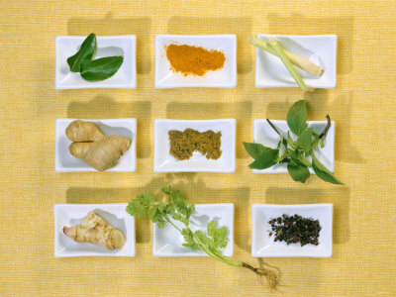
Herbs and Spices
Foundations of Restaurant Management and Culinary Arts
Book 1 Chapter 5

Slide 2
Herbs
Leaves, stems or flowers of an aromatic plant
Fresh or Dried
Dried herbs are stronger than fresh
When using dried herbs crumble or crush them to release flavor
Use 2-3 time more fresh then dried
Add fresh herbs at the end of cooking

Slide 3
Spices
Bark, roots, seeds, buds or berries of an aromatic plant.
Usually dried – ground or whole
Might be fresh, such as ginger
Store in tightly covered containers in cool dry place.

Slide 4
Name that Herb
Basil
Italian Cooking

Slide 5
Name that Herb
Bay
Soups, Stews, Meats
Use the whole leaf, but remove before serving

Slide 6
Name that Herb
Chives
Potatoes, Garnishes, Seafood, Soups

Slide 7
Name that Herb
Cilantro
Mexican Food, Thai Food, Sauces, Salsa

Slide 8
Name that Herb
Dill
Fish, Potatoes, Pickles, Dips, Carrots, Bread

Slide 9
Name that Herb
Lemon Grass
Chicken, Seafood

Slide 10
Name that Herb
Mint
Desserts, Lamb, Tea

Slide 11
Name that Herb
Oregano
Italian Food, Mexican Food, Pizza, Spaghetti

Slide 12
Name that Herb
Parsley
Garnish, Meat, Cheese, Salads, etc….

Slide 13
Name that Herb
Rosemary
Chicken, Seafood, Mushrooms, Vegetables

Slide 14
Name that Herb
Sage
Pork, Turkey, Stuffing, Mushrooms

Slide 15
Name that Herb
Tarragon
Chicken, Eggs, Mushroom, Seafood

Slide 16
Name that Herb
Thyme
Meat, Poultry, Mushrooms, Nuts, Potatoes

Slide 17
Name that Spice
Allspice
Tropical Evergreen Tree Berry
Nutmeg, Cloves, Cinnamon
Pickling, Stews, Baking

Slide 18
Name that Spice
Caraway
Apple, Pork, Sausage, Rye Bread

Slide 19
Name that Spice
Cayenne
Any food, but can add lots of heat!!

Slide 20
Name that Spice
Chili Powder
Blend of cumin, garlic, onion and chili
Tex-Mex, BBQ

Slide 21
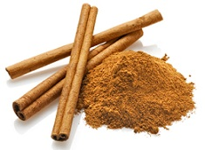
Name that Spice
Cinnamon
Bark of a tree
Baking, Sweets, Middle Eastern Dishes

Slide 22
Name that Spice
Cloves
Immature flower buds
Meats, Stocks, Sauces, Baking

Slide 23
Name that Spice
Coriander
Cilantro seeds
Variety of cooking uses in savory and baked foods

Slide 24
Name that Spice
Cumin
Seeds – used crushed
Mexican Foods, Chili

Slide 25
Name that Spice
Ginger
Root of plant
Baking, Asian Foods

Slide 26
Name that Spice
Nutmeg
Seed kernel inside a fruit
Baking, cheese, eggs, Alfredo

Slide 27
Name that Spice
Paprika
Finely ground powder from dried pepper
Garnish, salads, sausage, casseroles

Slide 28
Name that Spice
Peppercorn
Dried unripe berry
Most common – black pepper, used in most foods

Slide 29
Name that Spice
Poppy Seeds
From poppy flower
Baking, Salad Dressing

Slide 30
Name that Spice
Saffron
Dried stigmas of crocus
Most expensive spice in the world
Mediterranean and Asian foods

Slide 31
Name that Spice
Sesame Seeds
Found in the pod of a tropical plant
Baking, Tahini Paste, Asian Fish dishes

