Slide 1
Food Labels and Nutritional Values
Foods 2
Standard 3
Natalie Johnson

Slide 2
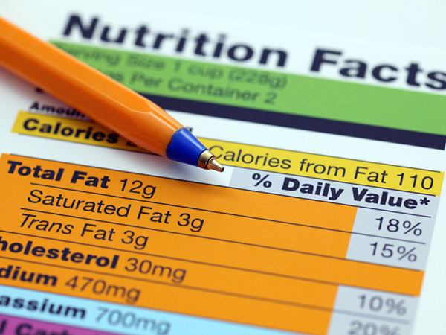
Nutrition Facts
The nutrition facts panel on a food package lists the calories, nutrients, number of servings, and portion size of food.

Slide 3
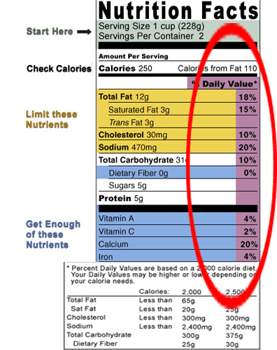
% Daily Value
Is the guide to the nutrients in one serving of food.
Example: if the label lists 15% for calcium, it means that one serving provides 15% of the calcium, needed for the day.

Slide 4
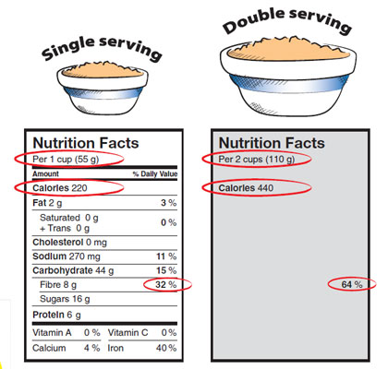
Serving Size
Nutrition information is given per serving.
Make sure to note the number of servings in a package before consuming it.

Slide 5
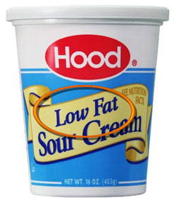
Food Labels – Low In
How you might see it on a label:
Low-fat, low-sodium, low- cholesterol, low-calorie
This term is used on foods that can be eaten often and consumers still wont get more than the recommended amount of that nutrient.

Slide 6
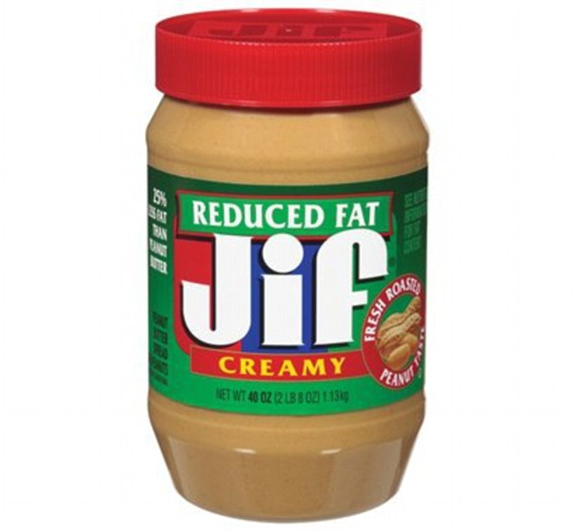
Reduced, less, light
Reduced contains 25% less of the ingredient. Fewer calories
Less contains 25% less of a nutrient or calories.
Light can mean lower calories, fat or sodium.

Slide 7
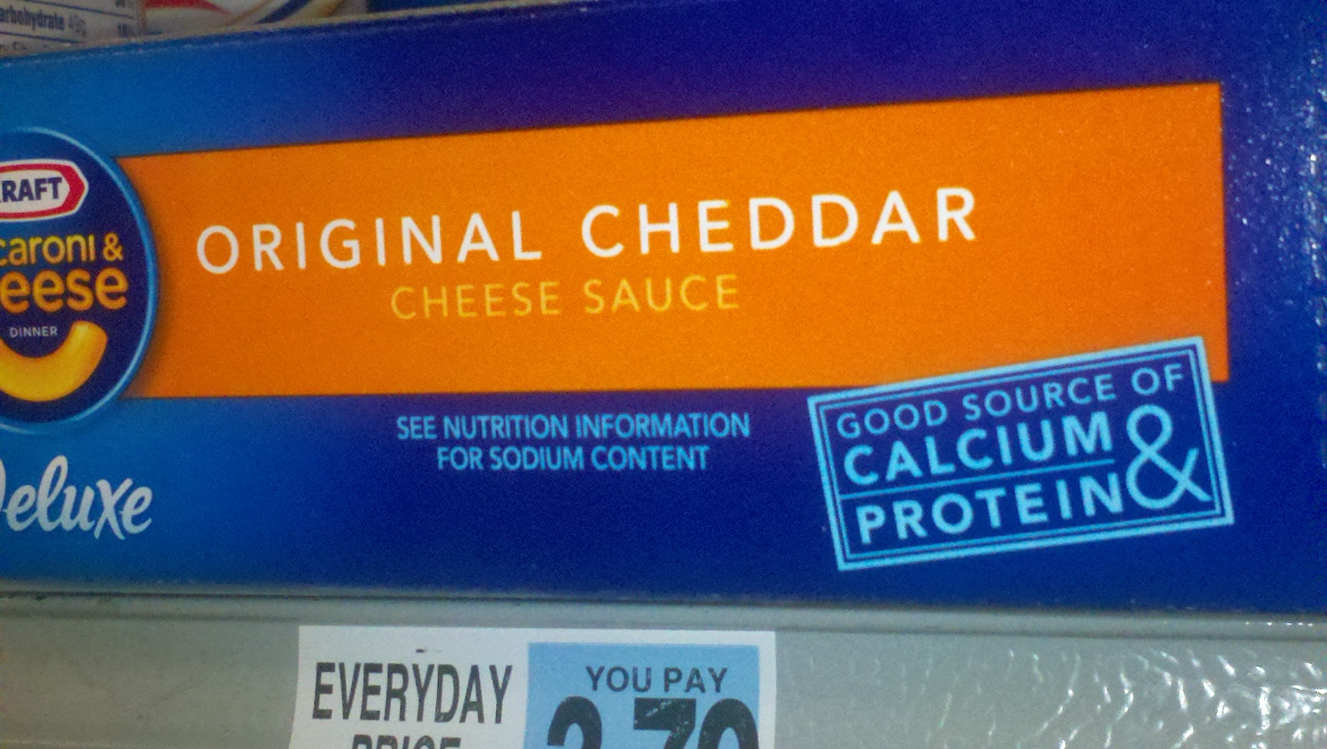
Good Source of…
Contains 10 to 19% more of the daily value for the nutrient than a comparable food per serving.

Slide 8
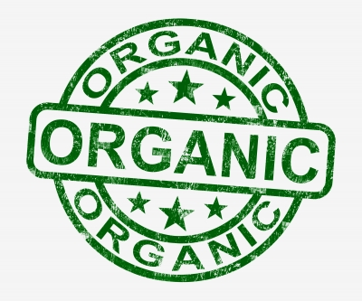
Organic and Natural
Organic: food is not genetically modified, produced without pesticides.
Natural: minimally processed, few additives such as dyes and sugars.

Slide 9
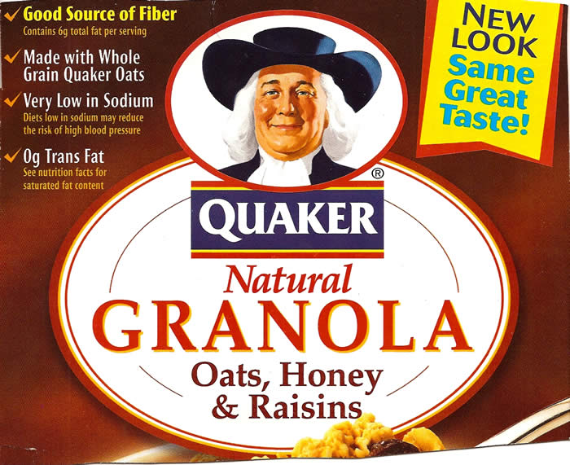
High Source of…
Provides at least 20% of the daily value for the nutrient of serving.

Slide 10
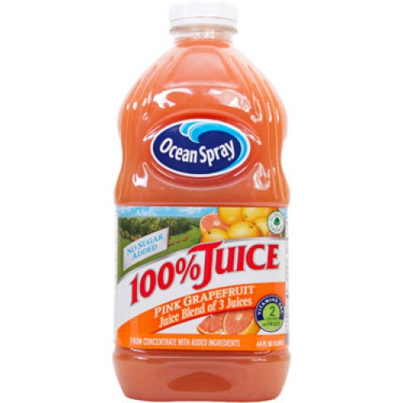
100% Juice vs. other drinks
To be labeled juice, a product must be 100% fruit or vegetable juice.
Juice cocktail: blend of 10 to 50 percent juice with water.

