Slide 1
Cooking Methods
ProStart Year 1, Chapter 5

Slide 2
Heat Transfer
Conduction – transfer of heat from one item to another. Surface to surface like a pot or in the air.
Convection – transfer of heat caused by the movement of molecules from a warmer area to a cooler one. Forced hot air is an example.
Radiation – no physical contact between heat source and the food. Heat is created by moving water molecules in the food creating friction. Goes from the outside of the food inside through conduction.

Slide 3
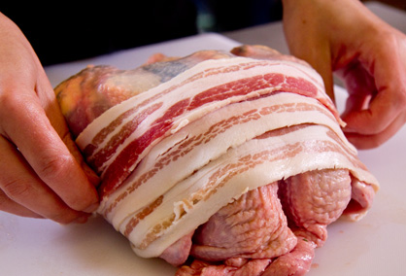
Dry Heat
Might need moisture
Barding – wrapping with strips of fat before cooking
(like bacon wrapped pork chop)
Larding – inserting long thin strips of fat into lean meat with a special needle before cooking
Marinating – soaking in a combination of wet and dry ingredients to provide moisture and flavor

Slide 4
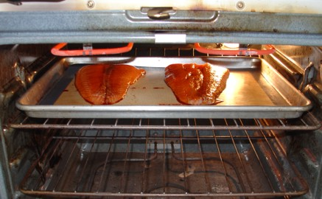
Broiling
Rapid cooking that uses high heat from a source located above the food. Food becomes brown on top. Watch the distance between the food and the heat source.

Slide 5
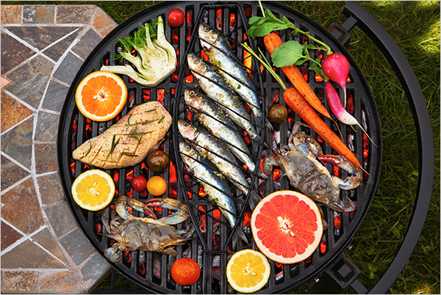
Grilling
Food is cooked on a grill rack above the heat source. No liquid is added. Great flavor outside, moist inside. BBQ is an example. Can use flavored wood to create great flavors in the food.

Slide 6
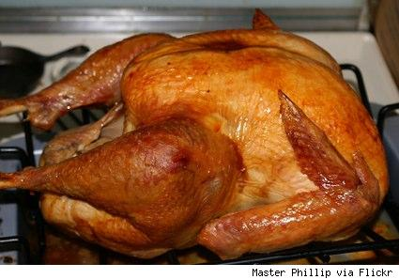
Roasting and Baking
Cook food by surrounding the items with hot, dry air in the oven. As the outer layers of food become heated, the food’s natural juiced turn to steam and are absorbed into the food.

Slide 7
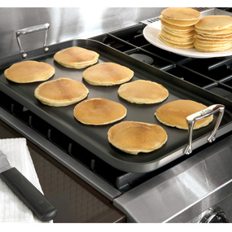
Griddling
Cooking a food item on a hot flat surface like a griddle or a fry pan.

Slide 8
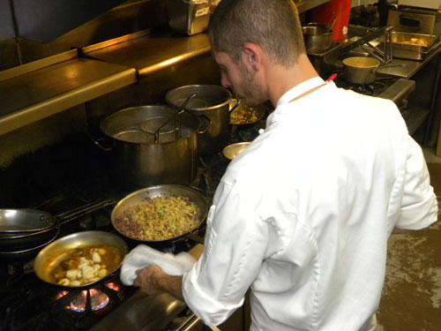
Sautéing
Cooks food rapidly in a small amount of fat over relatively high heat. The fat adds to the flavor. Heat the pan before adding the food.

Slide 9
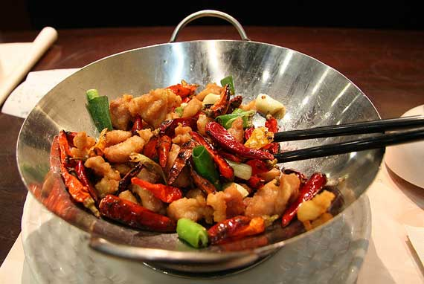
Stir-Fry
Similar to sauté. Quick, dry heat. Food is cooked over high heat, with a little fat but stirred quickly. Asian style of cooking. Cooked in a wok – small bottom, little fat.

Slide 10
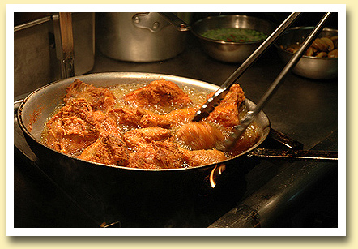
Pan Frying
Uses more fat, less intense heat than sautéing or stir-frying. Like fried chicken.

Slide 11
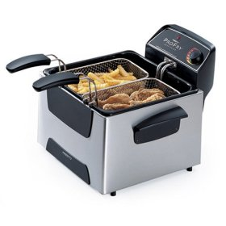
Deep-Frying
Submerged in fat, sometimes covered in batter or breading.

Slide 12
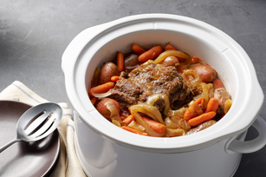
Moist Heat Cooking Methods
Moist delicately flavored food that sometimes makes a rich broth that can be used as a sauce base. An entire meal can be cooked in one pot using moist cooking methods.

Slide 13
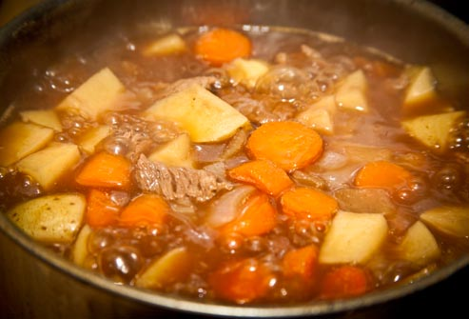
Simmering
Completely submerge food in a liquid that is at a constant moderate temperature. 185-205 degrees.

Slide 14
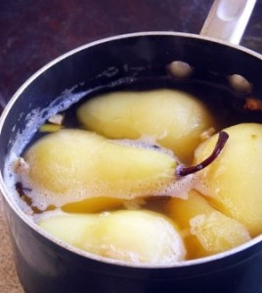
Poaching
Submerged like simmering, but lower temperature. Cook between 160-180 degrees. No air bubbles should break the surface.

Slide 15
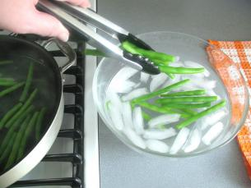
Blanching
Variation of boiling. Partially cook the food and finish it later. Used a lot for vegetables. Drop in boiling water, remove before completely cooked. Shock in ice water (stops cooking).

Slide 16
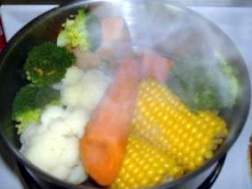
Steaming
Cook food by surrounding it in steam in a confined space. With our without pressure. No browning can occur.

Slide 17
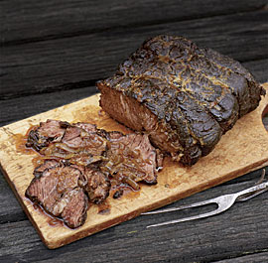
Combination Cooking
Combines Dry and Moist cooking methods.

Slide 18
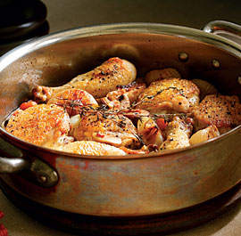
Braising
Sear the item first in hot oil, then partially cover in enough liquid to come half way up the food. Cover and finish the food slowly in the oven or stop top until tender. Long, slow cooking!!

Slide 19
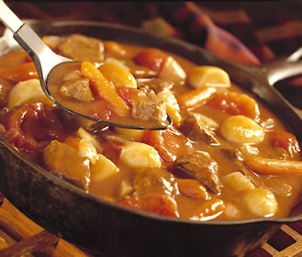
Stewing
Food it cut into bite size pieces and either blanched or seared. Stewing required more liquid than braising. Cover the food completely while it simmers.

